Slide 1
York Region, Canada Analysis for Opening a new Restaurant

Slide 2
Introduction
York Is a regional municipality in Southern, Canada, between Lake Simoce and Toronto. It replaced the former York County in 1971, and is part of the Great Toronto area and the inner ring of the Golden Horsshsoe. The regional government is headquartered in New Market.
The 2016 census population was 1,109,909, with a growth rate of 7.5% from 2011 to 2016. The Government of Ontario expects its population to surpass 1.5 million residents by 2031.

Slide 3
Problem
Problem
data might contribute to analyze and decide which Neighborhood is the best to open a restaurant in order to get a good profit , also the data would help to decide what kind of restaurant should be opened Asian , Italian etc…
Interest
An American Business Man is interested in opening a restaurant in York region
He wants to know what neighborhood is better in order to have a successful restaurant and have a good profit ,also he would like to know what kind of food is preferred to serve there This also helps with the success of the Restaurant

Slide 4
The Question ?
Where is the best neighborhood to open a new restaurant in York Region ?
What Type of restaurant would be the Most desirable by the citizens ?

Slide 5
Data sources an acuisitions
Data sources
First we need all the neighborhoods with its postal code , we took them from Wikipedia https://en.wikipedia.org/wiki/List_of_postal_codes_of_Canada:_M
A csv file for the latitude and longitude with the postal codes of Canada https://cocl.us/Geospatial_data also downloaded into a data frame
the statistics of the population of Canada and its neighborhoods with the
Average salary and second most common language which may help us to decide what kind of restaurant we need to open this also we found in Wikipedia
https://en.wikipedia.org/wiki/Demographics_of_Toronto_neighbourhoods

Slide 6
Data Cleaning
Data downloaded from the csv and scraped from the Wikipedia source for the neighborhoods were combined into one table
removing the rows in the first data frame when the BOROUGH is not assigned as it has no value
merging any rows which has the same postal codes , after that I created my data frame after including only York neighborhoods and exclude all others
Using the foursquare API in order to get all the venues for York region using the previous data frame and printing the venues were returned by Foursquare then I added the categories of the venues
Creating two data frames one with the restaurant venue categories and the other all venue categories except the restaurants
for the population data frame after scraping the data from Wikipedia , it must be cleaned and all the not necessary columns should be removed in my case
column FM should be filtered in order to distinguish the regions I queried only the values FM=="NY" or FM=="Y" or FM=="EY for York Region and set the index as Name of Neighborhood

Slide 7
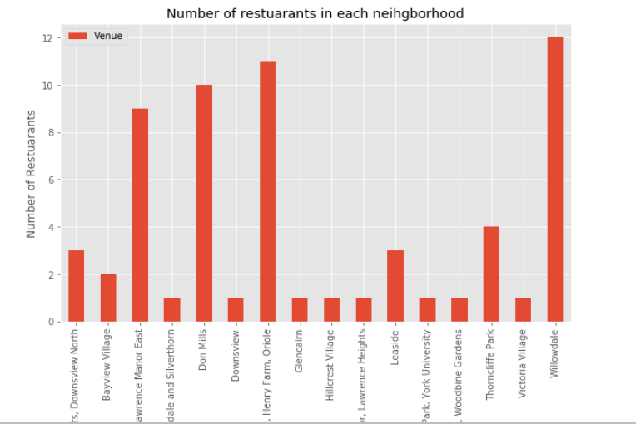
Bumber of Restaurants in each Neighborhood
the Neighborhoods with the smallest number of restaurants are
:'Bathurst Manor, Wilson Heights, Downsview North, Bayview Village, Del Ray, Mount Dennis, Keelsdale and Silverthorn' , 'Downsview', 'Glencairn','Hillcrest Village','Lawrence Manor, Lawrence Heights','Leaside,'Northwood Park, York University' ,'Parkview Hill, Woodbine Gardens','Parkview Hill, Woodbine Gardens','Victoria Village

Slide 8
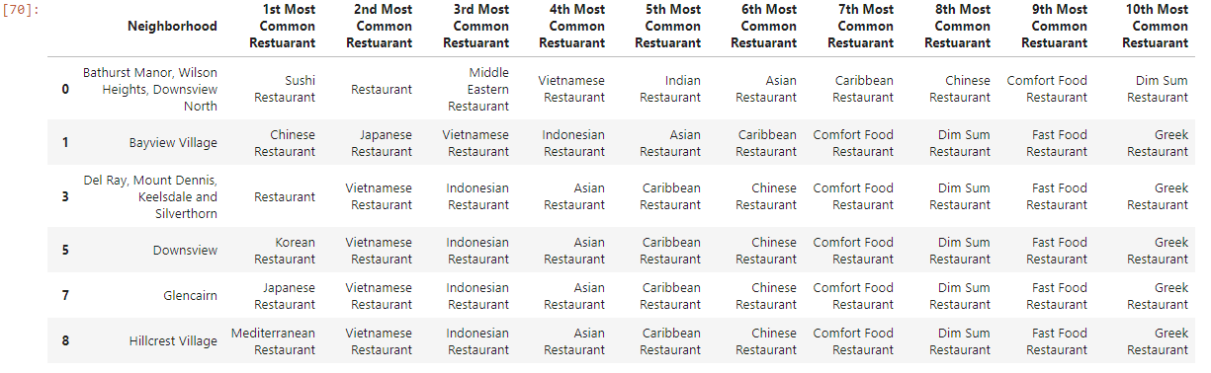
the neighborhoods which has the least number of restaurants and what are the most common trends

Slide 9
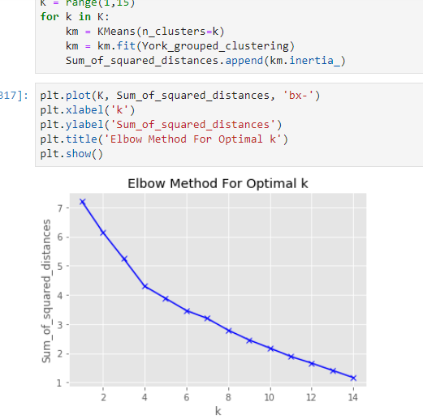
K mean Modeling foe clustering Evaluation of the Model
And after trying K=6, k=8,k=9
It was found that the best k is 6 so we will need 6 clusters as our data is not that big

Slide 10
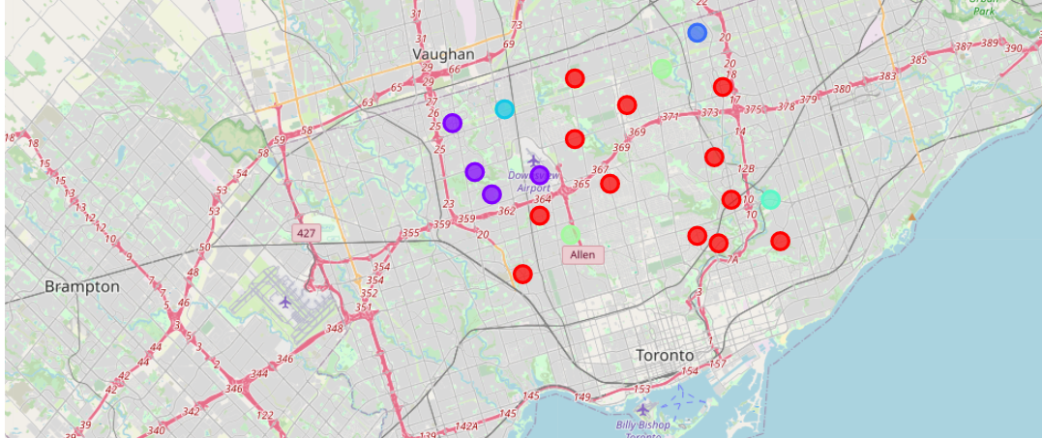
Distribution of the result of the clusters

Slide 11
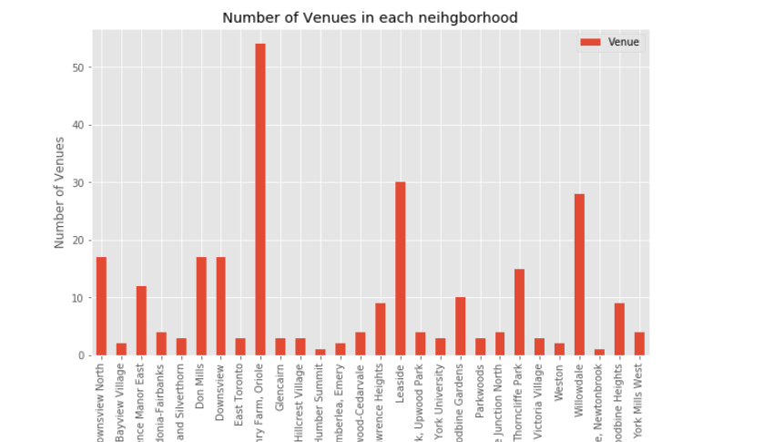
The neighborhoods with the biggest number of other popular venues
the neighborhoods which have the most number of venues are (the more exist the better as the restaurant will have a lot of visitors which will be hungry after any activity )
Bathurst Manor, Wilson Heights, Downs view North
Don Mills
Downsview
airview, Henry Farm, Oriole
Willowdale
Leaside

Slide 12
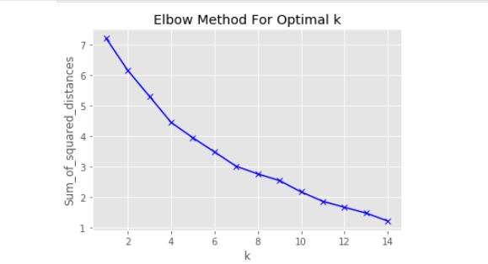
Modeling using k mean for the different similar venues
After trying some K numbers and based on this evaluation method K=8

Slide 13
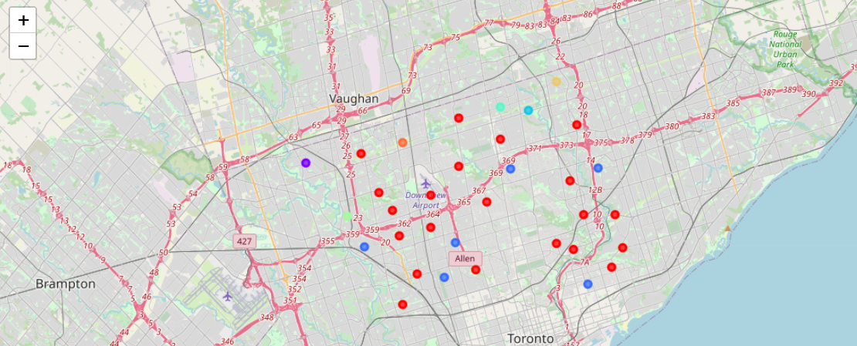
Distribution of Clusters using Foluim map

Slide 14
Aftrer exploring the clusters
Cluster 1 the most trended venues beer shop pizza place, clothing and cafe shop
we can see that Fairview, Henry Farm, Oriole and Willowdale and Don Mills are in tis cluster 1 so they have similar venues and as Willowdale has a big number of restaurants and they are all successful then in result all the neighborhoods in this cluster are in the save side

Slide 15
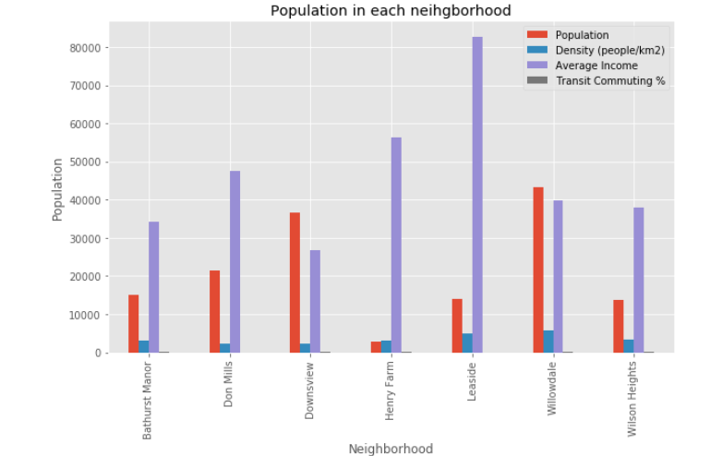
Using the bar plot to compare the neighborhoods with their average salary population and some other attributes as follows
Looking at the plot we can see that Willowdale has the biggest population and a good average salary
also Downsview has a good number of population and average salary
Leaside is not convenient as it has small number of population and it is the most important attribute but the salary average is high it can be cuz there is no big number of people live there

Slide 16
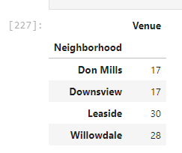
comparing results
by comparing the most populated and best salary average neighbor hoods with the biggest number Venues in each neighborhood the result is as follows
These are the best neighborhoods using the population salary average statistics and all other venues except restaurants similar clusters

Slide 17
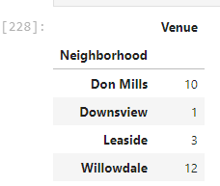
the number of restaurants for these neighborhoods
after comparing the two tables the best neighborhoods are Downs view and leaside , don mils also good choice but it has too many restaurants so is willowdale

Slide 18
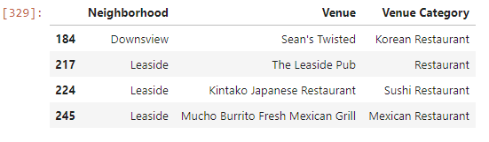
calculating the type of restaurants of these two neighborhoods

Slide 19
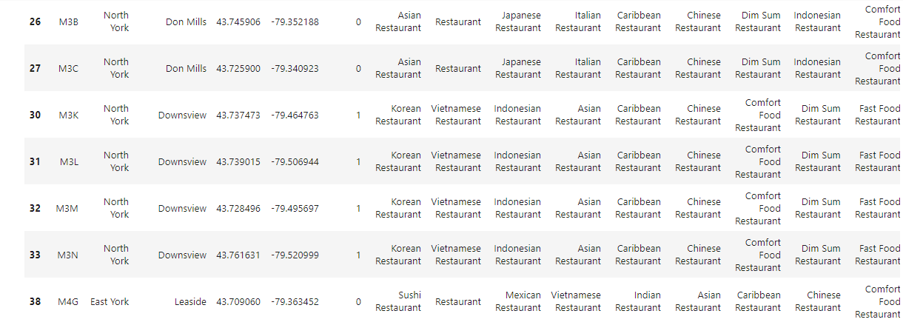
Comparing the clusters of the cosen neighborhoods

Slide 20
Results
Leaside , willodale and don mils cluster 1
Downsview cluster 2 based on this information as for venues except restaurants all these neighborhoods are in the same cluster so they have similar venues so tey all have similar number of customers and frequency on the other hand Downsview belongs to another cluster not similar to Willowdale for example in case of most common restaurants so this will help us to exclude all the common similar restaurants in cluster 1 and look only in cluster 2

Slide 21
Conclusion
looking at it all we can recommend to open a restaurant in Donsview as it has only one Korean restaurant
1-is neighborhood has a good population and good average salary
2-it has 11 percent of Italian native language speakers
3- and based on clustering the most trended restaurant categories are Asian categories
4-finally it has a good number of other venues
And there are few choices based on this Information to choose what kind of food is served
It could be Chinese or Vietnamese based on clustering or Italian Restaurant as there are no Italian food in this region and there are 11 percent of people speaks Italian.

